Slide 1
Combine Both Clicks and Code
to Build Customizable Mobile Apps
Michelle Paul
Director of Product Development, Patron Technology
michelle@patrontechnology.com
@fuzzydinosaur
David Esposito
CTO, Patron Technology
dave@patrontechnology.com

Slide 2
What is PatronManager?
Arts and culture organizations need CRM too!

Slide 3

PatronManager: Box Office Ticketing & Fundraising
(all within Salesforce!)
Our clients:
580+ arts & culture orgs
In the US and Canada
Theatres, orchestras, dance companies, museums
Their business:
Selling general admission and reserved seating tickets and subscriptions
$150M total credit card sales processed in 2014

Slide 4
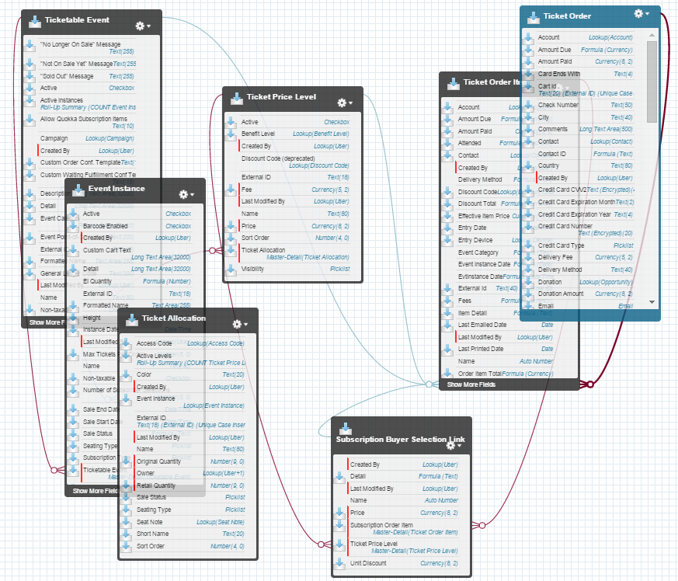
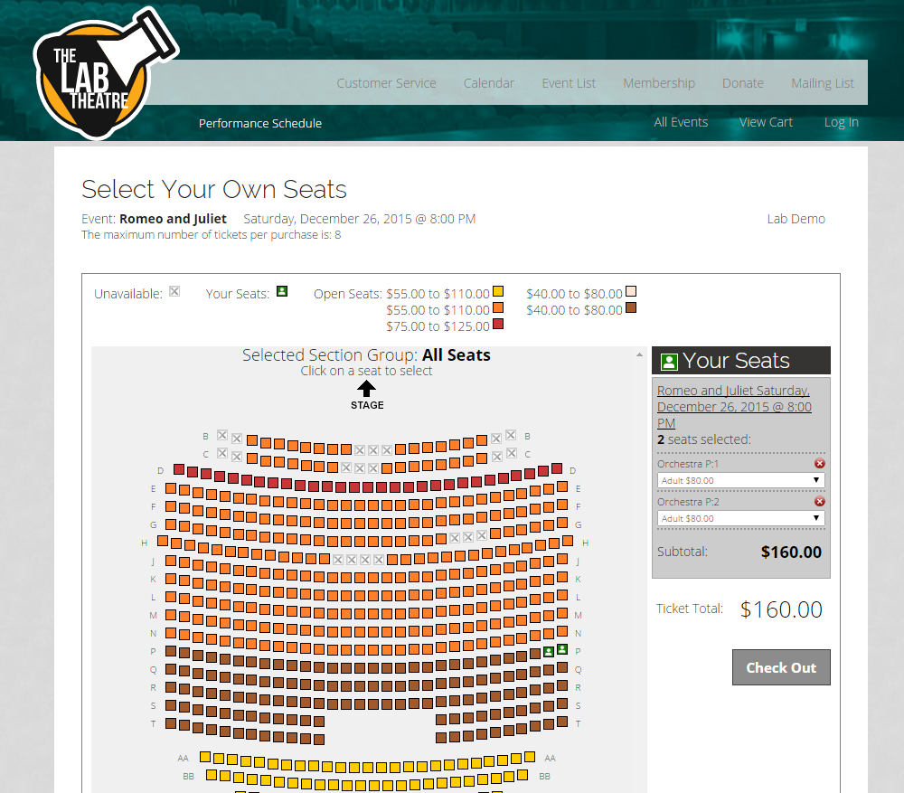
PatronManager: Box Office Ticketing & Fundraising
(all within Salesforce!)
8 managed packages
Custom objects
Event Inventory (Event, Price Level, etc)
Ticket Order, Ticket Order Item
Online ticketing too!
Lots of code…
And our Client Administrator team

Slide 5
PatronManager: Box Office Ticketing & Fundraising
What’s most important?
Do the tasks that need to get done
Quickly
Correctly
Securely
Build a relationship with patrons
By making them feel “known”
Source: PT Arts Patron Survey 2015

Slide 6
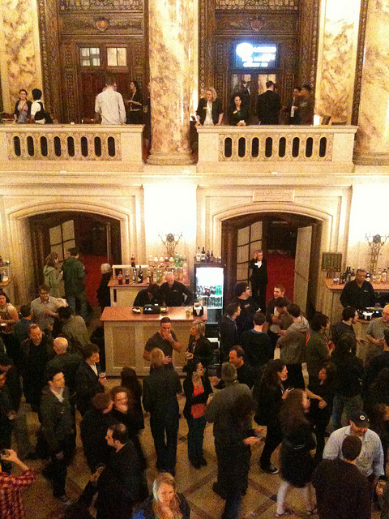
Peggy: Major donor
Megan: Former subscriber
Roger: First-time attendee
Betty: Board member
Francine: Betty’s friend
brokentrinkets

Slide 7
PatronManager: Combining Clicks & Code
HTML5 hybrid app using mobile SDK
Native hardware integration on Android
Apex REST for other apps
And button-click developer tools like Process Builder, Workflow, etc.

Slide 8
Box Office Express
For selling tickets quickly!

Slide 9
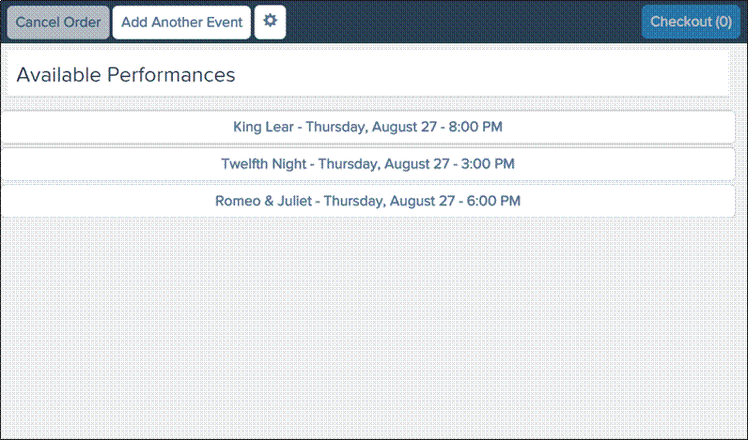
Box Office Express
Sell tickets from anywhere!
Sell quickly and easily
While still accessing customer data

Slide 10
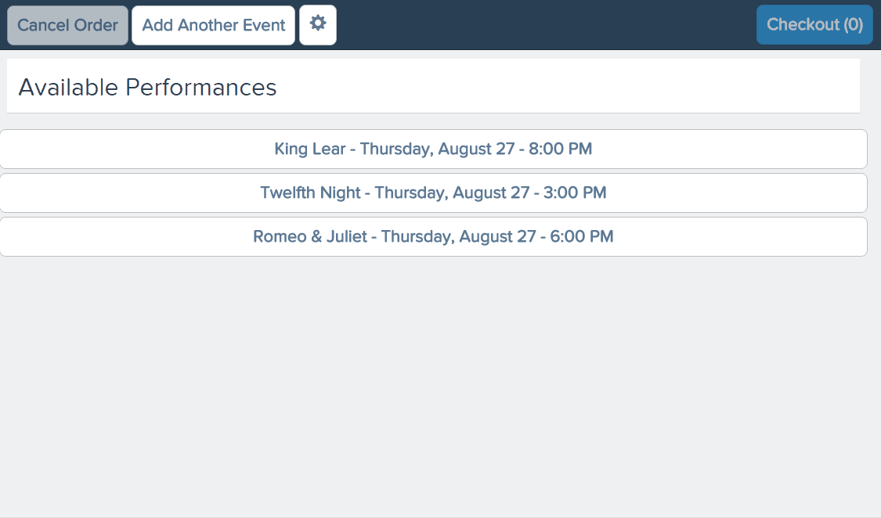
Box Office Express
Sell tickets from anywhere!
Sell quickly and easily
While still accessing customer data

Slide 11
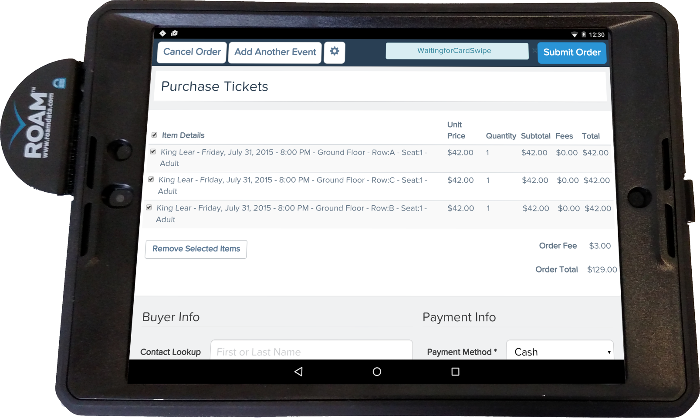
Box Office Express
Sell tickets from anywhere!
Nexus 9 tablet with swiper
Cash or credit card sales
Designed for speed

Slide 12
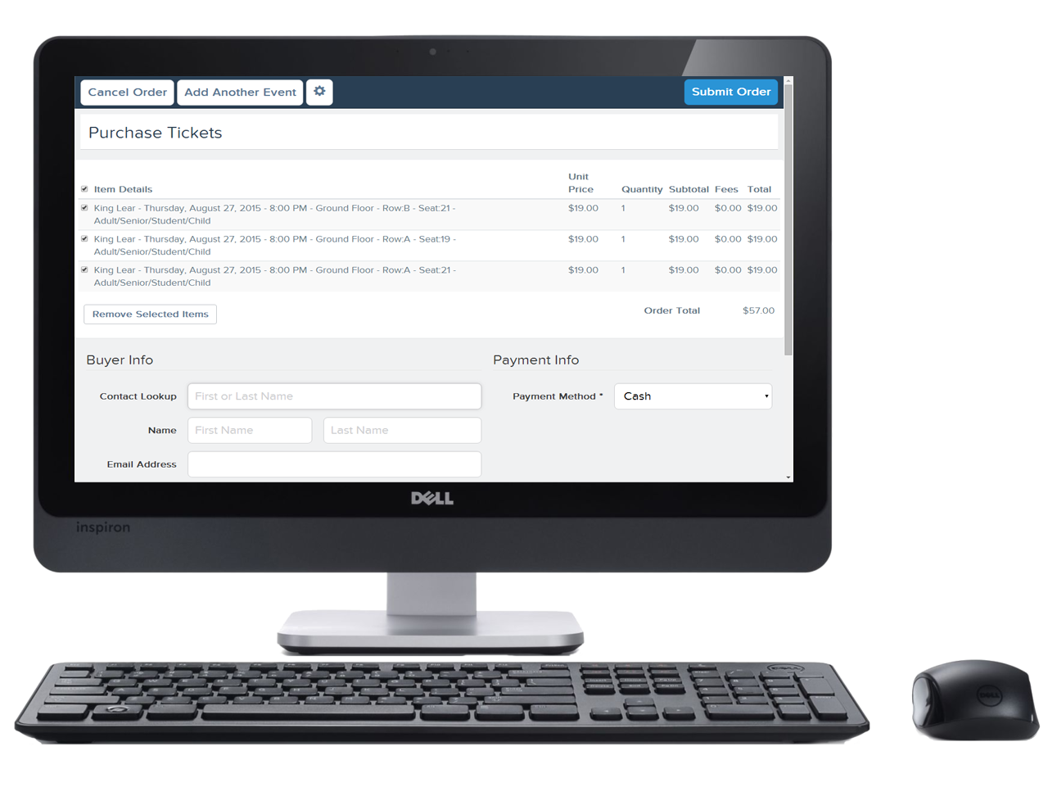
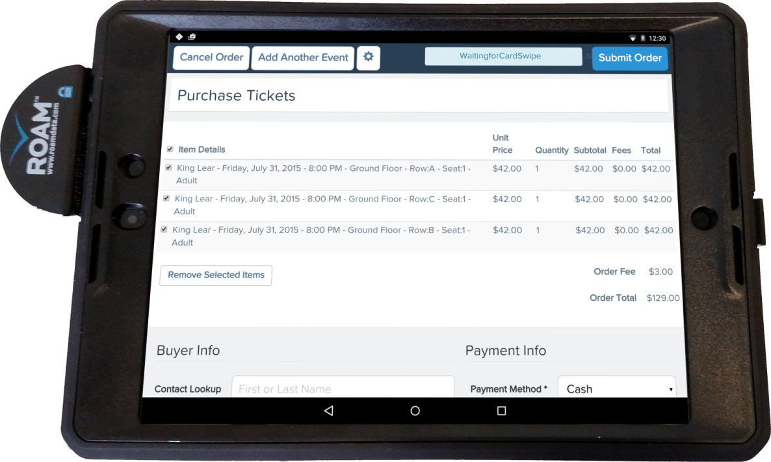
Box Office Express
How it's built
Visualforce page "hosting" Backbone.js app
Styling via Salesforce Foundation's SF1 build of Twitter Bootstrap
Can be delivered in Android hybrid container or desktop browser

Slide 13
Box Office Express
Android Hybrid App (Salesforce Mobile SDK)
Apex Controller
Architecture
Salesforce Mobile SDK bootstraps authentication
Visualforce page "hosting" Backbone.js app
Backbone app maintains cache of seat inventory to minimize roundtrips to SFDC
Visualforce Remoting to talk to SFDC
Cordova Plugins to talk to card swiper SDK and printing framework
VF
Remoting
@RemoteAction methods
Visualforce Page
Twitter Bootstrap
Backbone.js
Cordova
Cordova Plugins
Card Swiper SDK
Google Cloud Print

Slide 14
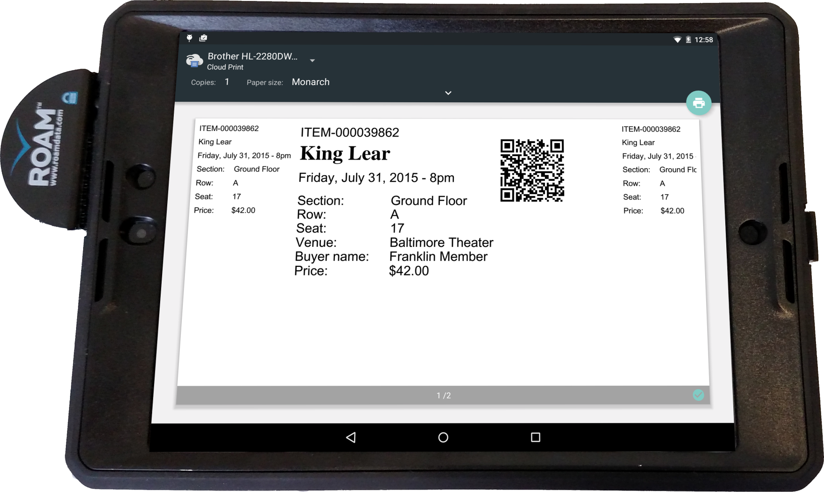
Box Office Express
Why Android Hybrid?
Native hardware access
Cordova plugins for interfacing with credit card swiper SDK
Keeps app out of PCI scope using Point to Point Encryption (P2PE) hardware
Ticket printing
via Android Printing Framework to Google Cloud Print
Allows us to control soft keyboard input layout

Slide 15
What Happens Next?
Creating custom processes based on real-time ticket sales

Slide 16
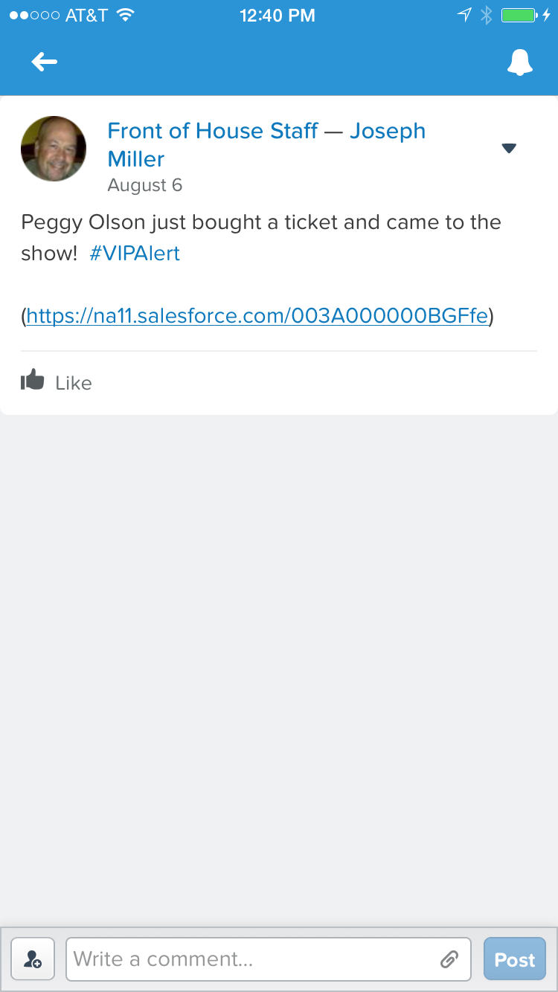
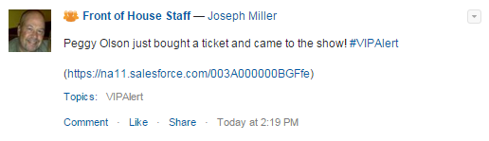
VIP Alerts
Real-time notifications about specific purchasers
Post to Chatter
Let the staff know when an important patron arrives
Get email / push notifications
Right on your phone with SF1
Or even on BOE tablet!

Slide 17
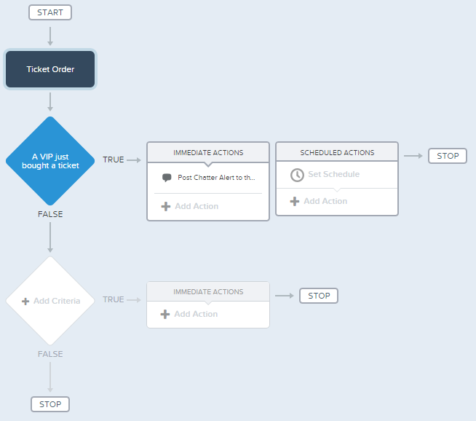
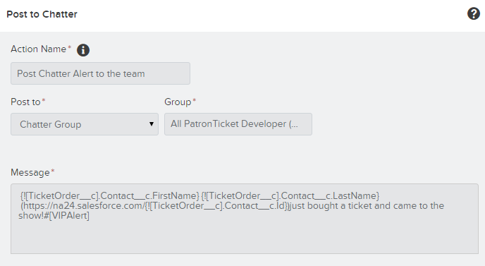
How We Did It
Process Builder!
Criteria:
New Ticket Order is created
Processed through Box Office Express
Attached to a VIP Contact
Action:
Post to the “Front of House” Chatter Group
Include a link to the Contact record
[Field] [Operator] [Type] [Value]
TicketOrder__c.OrderStatus__c Equals Picklist Complete
TicketOrder__c.EntryMethod__c Equals String BOE
TicketOrder__c.Contact__r.VIP__c Equals Boolean True

Slide 18
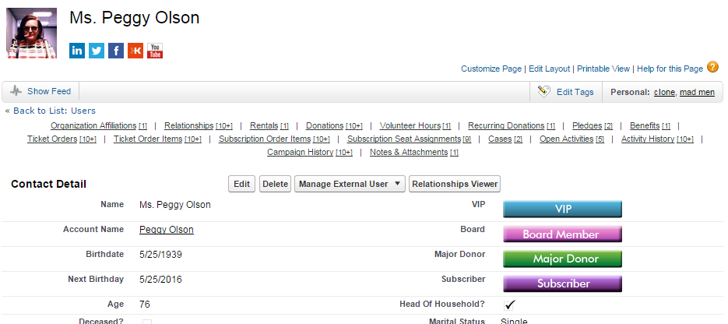
Why It’s Custom
What’s a “VIP”? Who should know about it?
Different definitions of “VIP”
Major Donors
Board Members
Repeat volunteers
Different staffing situations
Front of house staff
Development Director
Executive Director

Slide 19
Box Office Express
Demo

Slide 20
Barcode Scanning
Validate tickets and send alerts

Slide 21
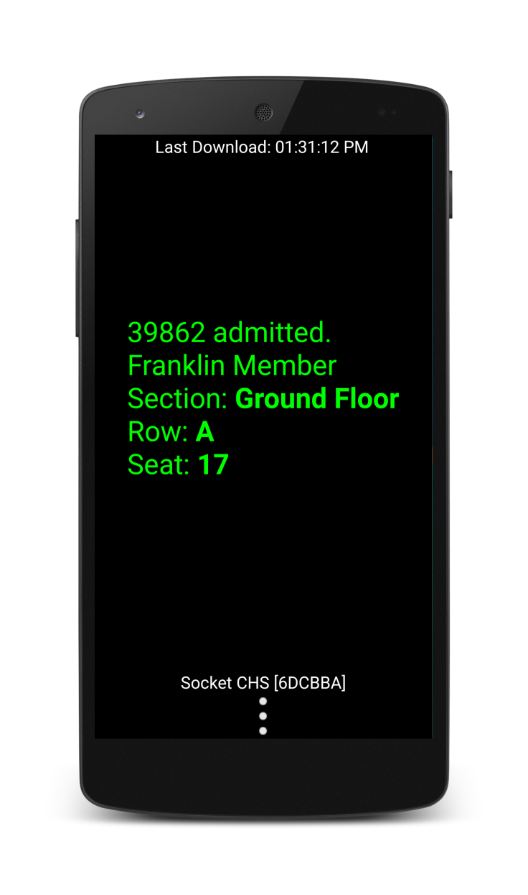
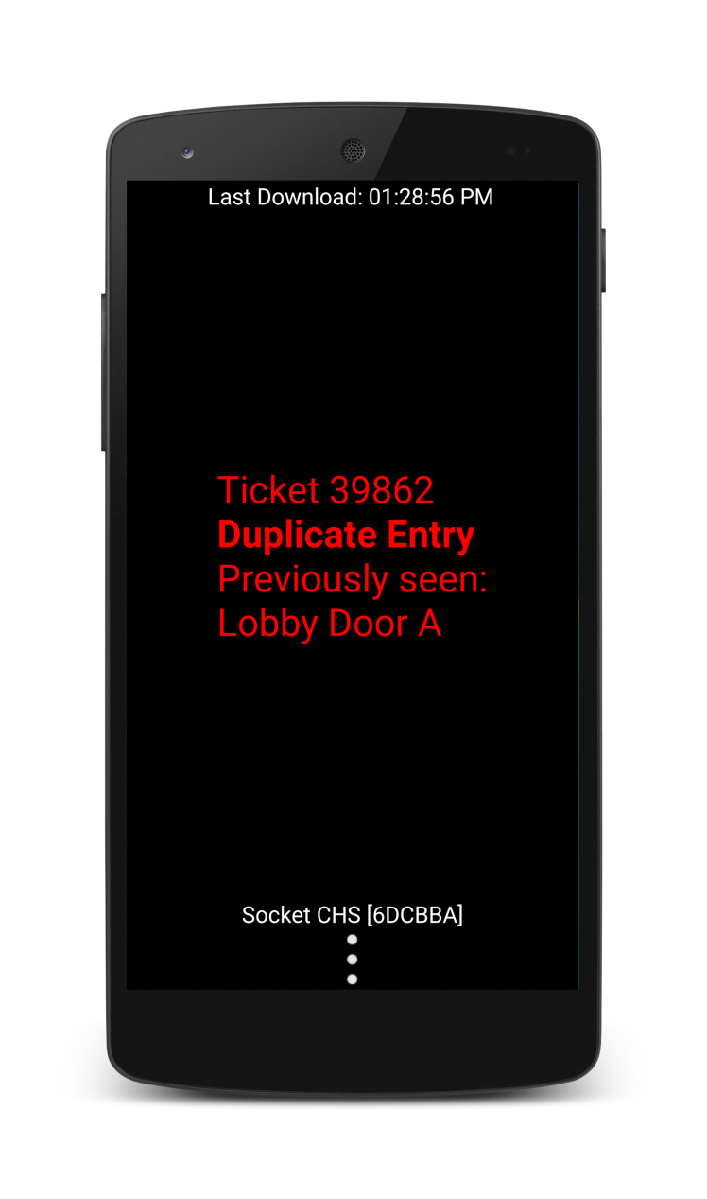
Barcode Scanning
Why?
Track attendance
Updates a field called “Entry Date” on Ticket Order Items
Access control
Warns the user if a ticket has already been scanned, or if it’s not a valid ticket

Slide 22
Barcode Scanning
How it works
100% native Android app
Integrates methods of QR code capture
Camera (cheap and cheerful; but a little slow)
SocketMobile Bluetooth 2D imager (must be paired with an Android device)
Validates ticket and updates Salesforce with admission date

Slide 23
What Happens Next?
Creating custom processes based on someone’s arrival

Slide 24
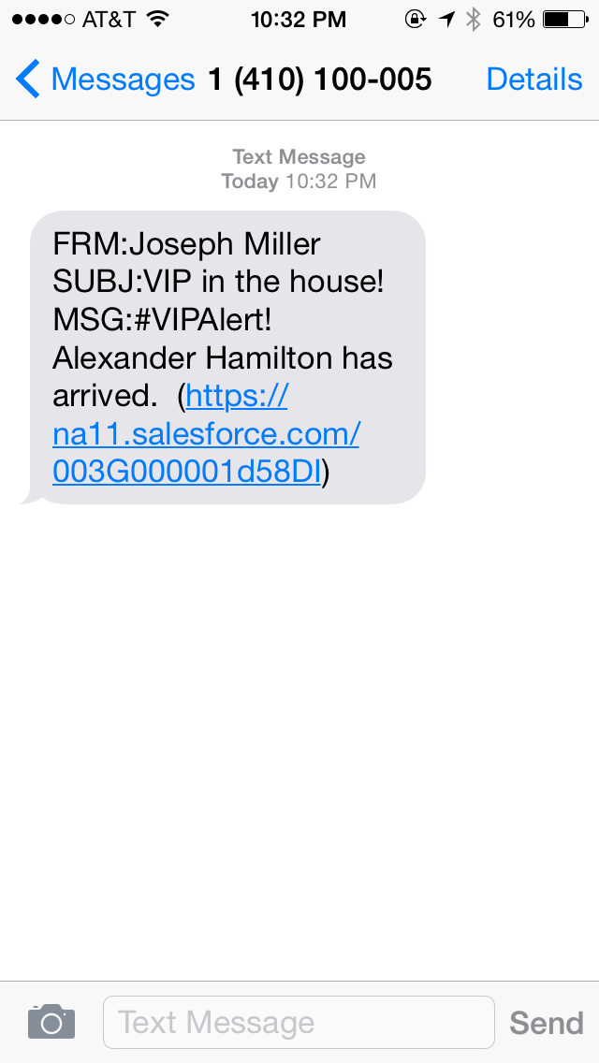
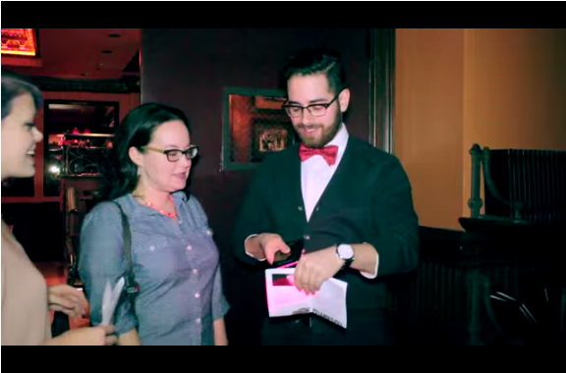
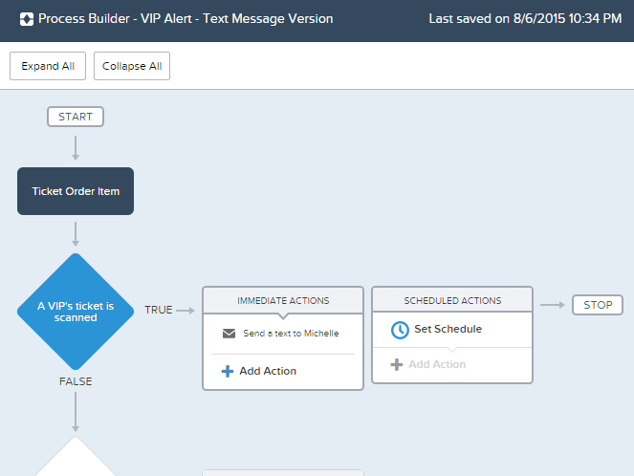
VIP Alerts – text message version (using Email Alerts)
“Elvis has entered the building!”
Criteria:
Ticket Order Item “Entry Date” exists
TOI belongs to a VIP Contact
Action:
Fire an Email Alert
Recipient = text-able email address (like 914-555-9311@txt.att.net)
Includes VIP Name & link to the Contact

Slide 25
Barcode Scanning
Quick Demo

Slide 26
In Conclusion
Our combined approach

Slide 27
Conclusion
Technology Used
 | Box Office Express | Barcode Scanner
Front End | HTML5 Twitter Bootstrap Backbone.js | Native Android
Back End | Visualforce Remoting Native Cordova Plugin | Apex REST Native integration with Scanner SDK
Declarative | Process Builder to fire a Chatter alert | Process Builder to email-to-SMS

Slide 28
Clicks and Code
Universal features with customized end results
Product, not consulting
Code for global requirements
Button-click development gives us a huge opportunity

Slide 29
Michelle Paul Director of Product Development, Patron Technology michelle@patrontechnology.com @fuzzydinosaur
David Esposito
CTO, Patron Technology
dave@patrontechnology.com

